Slide 1
Using segmentation to build a capability-based single address space operating system
Wuyang Chung
wy-chung@outlook.com
You can see the video on YouTube.

Slide 2
Outline
Single Address Space Operating System
Capability-based Addressing
Segmentation
Benefits of Segmentation
Compatibility with Old Programs
Conclusion

Slide 3
Single Address Space OS
Problems with multiple address space OS
  Pointers cannot be used in shared buffer
  On CPUs without ASID
    Need to flush TLB when doing address space switch
  On CPUs with ASID
    Duplications of translation information in TLB
Advantages of single address space OS
  Pointers can be used in shared buffer
  Lower context switch overhead
Challenge of single address space OS
  Protection

Slide 4
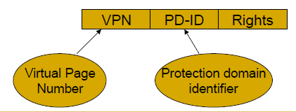
Multiple Protection Domains on a Single Address Space
Domain page model
  PLB (Protection Lookaside Buffer )
Page group model
  There is an AID (access identifier) field in page table entry
  A process can access a page if any of the PIDs is equal to the page AID
  The CPU has several PID (protection identifier) registers
Capability-based addressing
Architecture support for single address space operating systems, ACM SIGPLAN, 1992.
https://cseweb.ucsd.edu/classes/fa11/cse240A-a/Slides1/06_SAOS.pdf

Slide 5
Capability-based Addressing
capability
permissions
unique object ID
partitioned approach
capability-based
addressing
permissions
unique segment ID
p0
p1
C-list
C-list
The most important thing in a capability system is to prevent capability from being forged
Two approaches
  Tagged approach
    e.g. CHERI
  Partitioned approach
    e.g. Plessey 250
code
code
data
data
stack
stack
memory
Notes:
Capability Hardware Enhanced RISC Instructions (CHERI)

Slide 6
Capability-based Addressing
capability
permissions
unique object ID
partitioned approach
capability-based
addressing
permissions
unique segment ID
p0
p1
C-list
C-list
The most important thing in a capability system is to prevent capability from being forged
Two approaches
  Tagged approach
    e.g. CHERI
  Partitioned approach
    e.g. Plessey 250
code
code
data
data
stack
stack
memory
Notes:
Capability Hardware Enhanced RISC Instructions (CHERI)

Slide 7
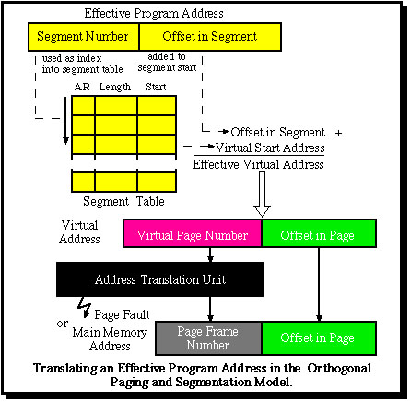
Orthogonal Segmentation and Paging
https://www.monads-security.org/orthogonal-segmentation-and-paging.html
logical address
virtual address
physical address

Slide 8
Segmentation
segment handle
capability table
segment metadata table
GPRs
code
tag
indexc
data
permsp0
PIDp1
tag
indexc
stack
PIDp0
p0
PIDp1
p1
base
size
attrs
GPRs
code
data
permsp1
tag
indexs
stack
tag
indexc
capability
kernel
permissions
unique segment ID
Notes:
tags is only used by IOMMU. When a device driver allocates a segment, it will return (tags, indexs) to the hardware device. Hardware device will treat this as a capability to the physical memory segment.
For physical segment that is not used for IOMMU, the metadata field tags can be empty.
OS will provide the following interface
To revoke segment handles
change capability.tagh
To revoke IOMMU capabilities
change metadata.tags
Only the owner can do these operations

Slide 9
Segmentation Hardware
Shadow registers
  used to cache indirect segment handle
SLB (Segment Lookaside Buffer)
  Cache segment translation
PID
Protection domain ID
cache tag
GPRs
shadow registers
data
direct
perms
PID
seg handle
PID
seg handle
perms
base
size
attrs
code
indirect
perms
PID
seg handle
PID
seg handle
perms
base
size
attrs
perms
PID
seg handle
…
perms
PID
seg handle
PID
seg handle
perms
base
size
attrs

Slide 10
Segment Types
Segmentation translates logical address to linear address
  There are 3 types of linear address
    Virtual, physical and I/O address
Segment types
  Virtual segment
    Linear address is virtual address
  Physical segment
    Linear address is physical address
  I/O segment
    Linear address is I/O address
logical address is
{segment handle, offset within the segment}

Slide 11
Benefits of Virtual Segment
Fast Segment move
  Don't need to copy the segment data, only need to copy the virtual to physical mapping
  Don't need to fix any pointers in the segment after the segment is moved

Slide 12
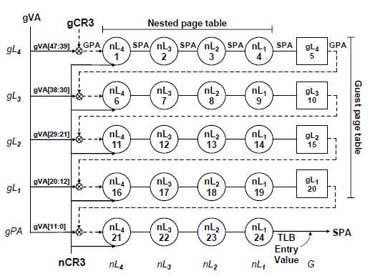
Simplification of page table walk in Guest Virtual Machine
On a guest machine, hardware needs to do two virtual address translations for TLB miss
  Guest virtual address to guest physical address
  System virtual address to system physical address
With virtual segment only one virtual address translation is needed
  Guest logical address can be translated directly to system virtual address
gVA
gPA
sPA
sVA
gLA
Two-Dimensional Page Table Walk
Accelerating two-dimensional page walks for virtualized systems,
acm ASPLOS, 2008
logical address is
{segment handle, offset within the segment}
Notes:
Whenever guest OS wants to allocate a segment
* It will do a hypervisor call and ask hypervisor to allocate a segment for it.
* Hypervisor will then return a capability to guest OS

Slide 13
Benefits of Physical Segment
Software-loaded TLB
  Must guarantee no TLB miss exceptions when the kernel is running the TLB miss handling routine
Direct segment
  Arkaprava Basu, Jayneel Gandhi, Jichuan Chang, Mark D. Hill, Michael M. Swift. Efficient virtual memory for big memory servers. In Proc. ISCA, 2013.
    TLB misses consume up to 51% of execution cycles for big memory servers
IOMMU simplification
  Simple authorization
  No page translation is needed
  IOMMU is simply a cache for physical segment metadata
DID
seg handle
perms
base
size
Device ID
This is not the permission in device driver’s capability. This is the permission specified by the driver for this DMA operation.

Slide 14
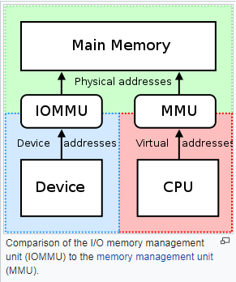
Simplification of IOMMU
How the IOMMU protects main memory from hardware device?
  Device driver allocates a physical segment and sends the segment handle to hardware device
  Device sends the segment handle, offset and data length to IOMMU
  IOMMU verifies that the segment handle is valid and it points to a physical segment
  IOMMU then checks that the offset and length is within segment size
  IOMMU calculates the physical address by adding segment base address and the offset
  The calculated physical address is used to access system main memory
From Wikipedia

Slide 15
I/O Segment
Purpose
  Leave memory address space to memory only and move all the other stuff to I/O address space, such as CPU’s CSRs, PCI configuration space, video frame buffer, boot ROM, etc.
Benefits
  No memory holes in memory address space
  Segment is more fine-grained then page
  For a large I/O buffer, only one SLB entry is needed
  The same load instruction can be used to load from either I/O or memory address space
  Even when a device driver runs at the user level, it can access its hardware device without kernel intervention

Slide 16
Simplification of Shared Library
No need for PIC (Position Independent Code), GOT (Global Offset Table) and PLT (Procedure Linkage Table)
  Shared library has its own code and data segments and segment always starts with offset 0
Shared libraries can be partially linked
  The offset part of the library’s global variables and functions can be statically linked at compile time
  The capability descriptor of the library’s global variables and functions are linked at program load time
Notes:
If got, plt is removed, the program can not find the symbol after the shared library is modified. With GOT, PLT, even when the shared library is recompiled, the global symbol can still be accessed because of GOT and PLT.

Slide 17
Cross-process Call
Cross-process call has many names:
cross-domain call, migrating thread model, protected control transfer, passive object model
Traditionally thread is confined in two protection domains
  When a thread is in the kernel, it can only return back to its creator process
Cross-process Call
  When a thread is in the kernel, it is allowed to upcall into other process
Benefits
  Encourage modularity and improve security
  Resource accounting can be made more accurate
  Preferable for real-time systems
Notes:
Cross-domain call is the most efficient way of doing IPC
Thread should be able to transfer to other domain in a protected way

Slide 18
Simplification of Cross-process Call
The same stack segment can be used in both client and server process if we can
  Protect the client part of the stack from server
    By using spmin
  Protect the server part of the stack from client
    By moving the stack capability from client process to server process
Need two new privileged registers
    spmin
      Thread can only access the part of the stack above this address
    spmax
      Automatically updated by CPU when sp is greater than spmax
      Used for stack cleaning before and after cross-process call

Slide 19
Compatibility with Old Programs
0
old
program
4G segment
Ideal platform
  32-bit programs on 64-bit virtual address space
The first half of the virtual address space is reserved for old programs
The second half of the virtual address space is for kernel, subsystems, device drivers and single-address-space programs
...
old
program
4G segment
kernel
subsystems
drivers
new
programs
single
address
space
Notes:
vDSO: virtual dynamic shared object

Slide 20
Conclusion
Lots of benefits we can get from single address space, capability and segmentation
Changes
  OS
    Segment, Capability and single address space
  Compiler
    Far pointer, far function call
    New shared library implementation
  Hardware
    Capability and segmentation architecture

Slide 21
The End
Thank you

Slide 22
Stack Growth Direction
Stack should grow towards ∞ instead of 0
  Can expand the stack segment when it reaches its maximum size
base
0
sp
base
0
stack
segment
stack
segment
sp
segment size
size
new size
towards 0
towards ∞

Slide 23
Data Address Space Partition
far segment
const data
0
There are 6 data segments for a thread
  constant data
  data
  stack
  thread local storage
  heap
They can share one data address space
  Don’t need to use far pointer for pointers points to them
data
stack
thread local storage
1G
heap
4G

